Slide 1




Advanced Syntax
Associative Arrays,
Multidimensional Arrays and Functions
Advanced Syntax
SoftUni Team
Technical Trainers
Software University
http://softuni.bg

Slide 2


Table of Contents
Associative Arrays
Array Manipulation
Multidimensional Arrays
Functions
Return statement
Procedures
Arguments
Type hinting
Variables scope

Slide 3
Questions
sli.do #PHP-Web

Slide 4


Associative Arrays
[key => value]

Slide 5
Associative Arrays (Maps, Dictionaries)
Associative arrays are arrays indexed by keys
Not by the numbers 0, 1, 2, 3, …
Hold a set of pairs <key, value>
Traditional array
Associative array
key
value
key
0 1 2 3 4
orange | 2.30
apple | 1.50
tomato | 3.80
value
8 | -3 | 12 | 408 | 33

Slide 6
Phonebook – Associative Array Example
$phonebook = [];
$phonebook["John Smith"] = "+1-555-8976"; // Add
$phonebook["Lisa Smith"] = "+1-555-1234";
$phonebook["Sam Doe"] = "+1-555-5030";
$phonebook["Nakov"] = "+359-899-555-592";
$phonebook["Nakov"] = "+359-2-981-9819"; //
unset($phonebook["John Smith"]); // Delete
echo count($phonebook); // 3

Slide 7
Associative Arrays in PHP
Initializing an associative array:
Accessing elements by index:
Inserting / deleting elements:
$people = array(
'Gero' => '0888-257124', 'Pencho' => '0888-3188822');
echo $people['Pencho']; // 0888-3188822
$people['Gosho'] = '0237-51713'; // Add 'Gosho'
unset($people['Pencho']); // Remove 'Pencho'
print_r($people); // Array([Gero] => 0888-257124 [Gosho] => 0237-51713)

Slide 8

Iterating Through Associative Arrays
foreach ($array as $key => $value)
Iterates through each of the key-value pairs in the array
$greetings = ['UK' => 'Good morning', 'France' => 'Bonjour', 'Germany' => 'Guten Tag', 'Bulgaria' => 'Ko staa'];
foreach ($greetings as $key => $value) {
echo "In $key people say \"$value\".";
echo "<br>";
}

Slide 9
Problem: Sum by Town
Read towns and incomes (like shown below) and print a array holding the total income for each town (see below)
Sofia
20
Varna
3
Sofia
5
Varna
4
Print the towns in their natural order as object properties
["Sofia" => "25","Varna" => "7"]

Slide 10
Solution: Sum of Towns
$arr = ['Sofia','20', 'Varna','10', 'Sofia','5'];
$sums = [];
for ($i = 0; $i < count($arr); $i += 2) {
list($town, $income) = [$arr[$i], $arr[$i+1]];
if ( ! isset($sums[$town]))
$sums[$town] = $income;
else
$sums[$town] += $income;
}
print_r($sums);
list($town,..)
Assign variables as if they were an array

Slide 11
Problem: Counting Letters in Text
$text = "Learning PHP is fun! ";
$letters = [];
$text = strtoupper($text);
for ($i = 0; $i < strlen($text); $i++) {
$char = $text[$i];
if (ord($char) >= ord('A') && ord($char) <= ord('Z')) {
if (isset($letters[$char])) {
$letters[$char]++;
} else {
$letters[$char] = 1;
}
}
}
print_r($letters);
isset($array[$i])
checks if the key exists

Slide 12


Practice: Associative Arrays
Live Exercises in Class (Lab)

Slide 13
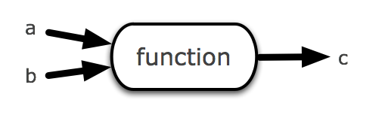
Functions
Organize and reuse the code

Slide 14
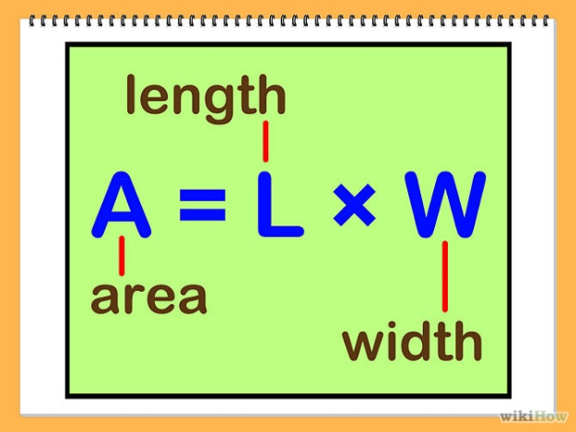
Functions
Functions are named blocks of code
Declared with the keyword function
Can accept parameters and return value
Help organize and reuse the code
function rectangleArea($sideA, $sideB) {
return $sideA * $sideB;
}
echo rectangleArea(5, 6);

Slide 15
Default Parameter Values
function strIsEqual($str1, $str2, $ignoreCase = true) {
if ($ignoreCase) {
$result = strtolower($str1) == strtolower($str2);
} else {
$result = $str1 == $str2;
}
return $result;
}
echo strIsEqual("nakov", "NaKOv", true); // 1 (true)
echo strIsEqual("nakov", "NAKOV"); // 1 (true)
echo strIsEqual("nakov", "Nakov", false); // "" (false)

Slide 16
Functions Parameters: Pass by Reference
By default PHP passes arguments to functions by value
Changed arguments in the function will be lost after it ends
To force pass by reference use the & prefix
function changeValue(&$arg) {
$arg += 100;
}
$num = 2;
echo $num . "\n"; // 2
changeValue($num);
echo $num; // 102

Slide 17
Variable Number of Arguments
PHP supports variable-length function arguments
Read the arguments: func_num_args() and func_get_args()
function calcSum() {
$sum = 0;
foreach (func_get_args() as $arg) {
$sum += $arg;
}
return $sum;
}
echo calcSum(1, 2), '<br />'; // 3
echo calcSum(10, 20, 30), '<br />'; // 60
echo calcSum(10, 22, 0.5, 0.75, 12.50), '<br />'; // 45.75

Slide 18
Variable Number of Arguments (2)
PHP 5.6+ may include the ... token
Read the arguments: …$params
function calcSum(...$params) {
$sum = 0;
foreach ($params as $arg) {
$sum += $arg;
}
return $sum;
}
echo calcSum(1, 2), '<br />'; // 3
echo calcSum(10, 20, 30), '<br />'; // 60
echo calcSum(10, 22, 0.5, 0.75, 12.50), '<br />'; // 45.75

Slide 19
Returning Values from a Function
Functions can return values with the return statement
Accepts only one argument – the value to be returned
Exits the function
To return multiple values you can use arrays
It’s not obligatory for a function to return a value
function example($arg) {
return true;
// The following code will NOT be executed
echo $arg + 1;
}

Slide 20
Returning Multiple Values from a Function
You can use fixed-size arrays to return multiple values
The list keyword assigns multiple variables from array items
list is NOT a function, but a language construct
Works only for numerical arrays and assumes indexes start at 0
function smallNumbers() {
return [0, 1, 2];
}
list($a, $b, $c) = smallNumbers();
echo "\$a = $a; \$b = $b; \$c = $c";

Slide 21
Type Hinting/Declaration
In later version of PHP you can hint the expected type of the arguments
In PHP 7+ You can also hint the return type of the function
By default, PHP will coerce values of the wrong type into the expected scalar type if possible.
It is possible to enable strict mode on a per-file basis.
declare(strict_types = 1); // Strict mode
function example(int $arg): int {
// The returned result should be int
return $arg + 1;
}

Slide 22
Variable Functions
PHP supports variables holding a function
The function name is stored as string value
Can be invoked through the () operator
function printSomething($arg) {
echo "This is function. Arg = $arg";
}
$a = 'printSomething';
$a(5); // This invokes the printSomething(5) function

Slide 23
Few Notes on Functions
You can check if function is declared with function_exists($name)
Functions can be nested (declared inside other functions)
Once the first function is called, the second gets globally defined
if ( ! function_exists('func')) {
function func($arg) { return true; }
}
function first($args) {
function second($args) { … }
second('hello');
}

Slide 24
Anonymous Functions
Anonymous functions are functions with no name
In PHP Closures are usually implemented that way
$array = array("Team Building, Vitosha", "Nakov", "studying programming", "SoftUni");
usort($array, function($a, $b) {
return strlen($a) - strlen($b);
});
print_r($array);

Slide 25
Function Overloading
In C# / Java / C++ functions can be overloaded
Function overloading == same name, different parameters
PHP (like Python and JavaScript) does not support overloading
function printName($firstName, $lastName = NULL) {
$name = $firstName;
if (isset($lastName))
$name .= ' ' . $lastName;
echo $name;
}
Simulate overloading by parameter checks AVOID THIS
printName('Maria');
printName('Maria','Nikolova');

Slide 26
Problem: Symmetry Check (Palindrome)
Write a function to check a string for symmetry
Examples: "abcccba" → true; "xyz" → false
function isPalindrome($str) {
for ($i = 0; $i < strlen($str) / 2; $i++)
if ($str[$i] != $str[strlen($str) - $i - 1])
return false;
return true;
}
isPalindrome("abba"); // true

Slide 27
Problem: Day of Week
Write a function to return the day number by day of week
Example: "Monday" → 1, …, "Sunday" → 7, other → "error"
PHP functions can return mixed data type: e.g. number or string
function dayOfWeek(string $day) {
if ($day == 'Monday') return 1;
…
if ($day == 'Sunday') return 7;
return "error";
}
dayOfWeek("Monday"); // 1

Slide 28

Practice: Functions
Live Exercises in Class (Lab)

Slide 29

Variables Scope

Slide 30
Variables Scope
The arrays $_GET, $_POST, $_SERVER , $_REQUEST and other built-in variables are global
Can be accessed at any place in the code
Variables, declared in functions
Exist only until the end of function (local function scope)
Files being included inherit the variable scope of the caller
Variables declared outside of a function are not accessible in it
$name = $_GET['firstName'] . $_GET['lastName'];

Slide 31
The Global Keyword
Variables outside of a function are not accessible in it:
To access an external variable use the global keyword
$a = "test"; // global scope
function foo() {
echo $a; // This will not output anything (local scope)
}
foo();
$a = "test";
function foo() {
global $a; // the global variable $a is included in the scope
echo $a; // this will output "test";
}
foo();

Slide 32
Loops and Variable Scope
Variables, declared in loops are accessible after the loop ends
A variable in PHP is declared with its first assignment
for ($i = 0; $i < 5; $i++) {
$arr[] = $i;
}
print_r($arr); // outputs 0, 1, 2, 3, 4
$a = 15;
if ($a == 5) { $five = 'five'; }
else { $five = 'not five'; }
echo $five; // not five

Slide 33
Static Keyword
Static variables in PHP are initialized only once (on demand)
Their existing values are preserved in the next function calls
function callMe() {
static $count = 0; // initialized at the first call
$count++; // executed at each function call
echo "callMe() is called $count times\n";
}
callMe(); // callMe() is called 1 times
callMe(); // callMe() is called 2 times

Slide 34

Summary
PHP supports associative arrays
Key=>Value pairs
PHP code may define and invoke functions
Functions may take parameters and return value
Functions support type hinting/declaration
Variadic functions are supported
Function overloading is not supported

Slide 35







PHP Basic Syntax
https://softuni.bg/courses/php-basics

Slide 36
License
This course (slides, examples, demos, videos, homework, etc.) is licensed under the "Creative Commons Attribution-NonCommercial-ShareAlike 4.0 International" license

Slide 37





Trainings @ Software University (SoftUni)
Software University – High-Quality Education, Profession and Job for Software Developers
softuni.bg
Software University Foundation
softuni.org
Software University @ Facebook
facebook.com/SoftwareUniversity
Software University Forums
forum.softuni.bg

